Slide 1
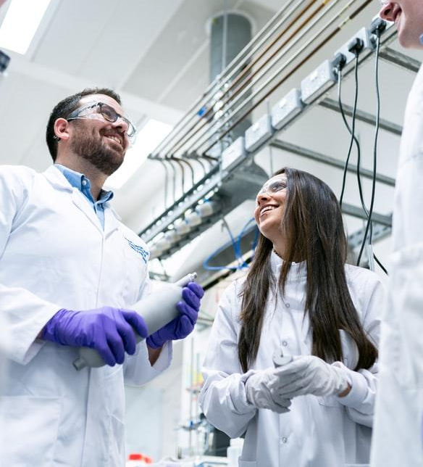
COVID-19 Image Recognition using Deep Learning

Slide 2
Agenda:
•Business Objective
•Dataset Resource
•Preprocessing
•Model Building
•Model Evaluation

Slide 3

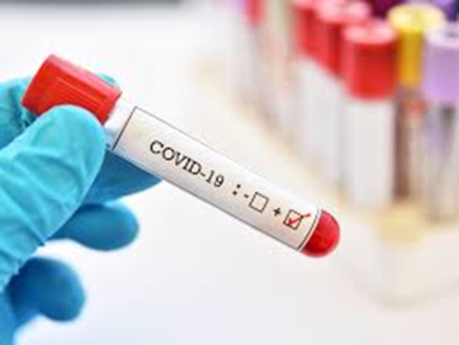
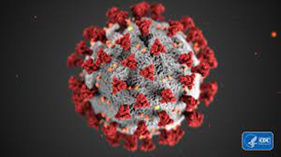
Business Objective
To identify if a patient is Covid positive or negative using Image recognition from Radiology scans.
Demonstrating the Confidence of a deep learning model in predicting whether or not a patient is disease-free.

Slide 4
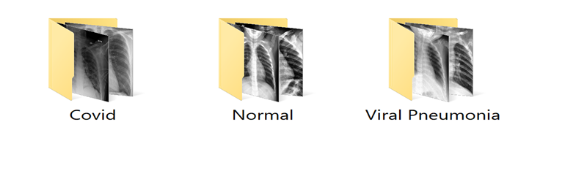
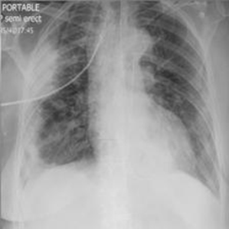
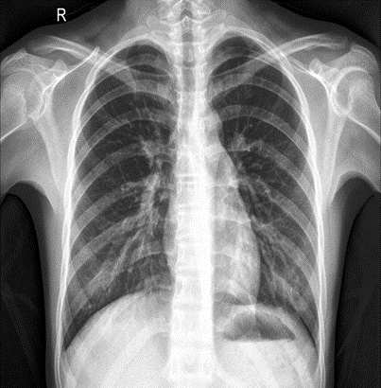
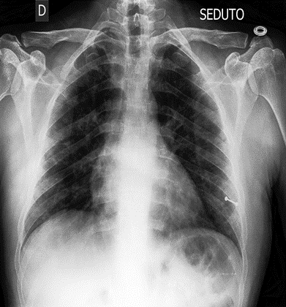
Dataset Resource
•I have taken the dataset from Kaggle.
•Dataset consists of three Directories.
•Dataset Size- 200MB with 3000 Images.

Slide 5
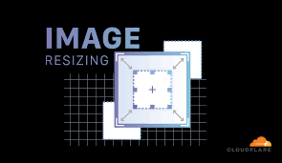
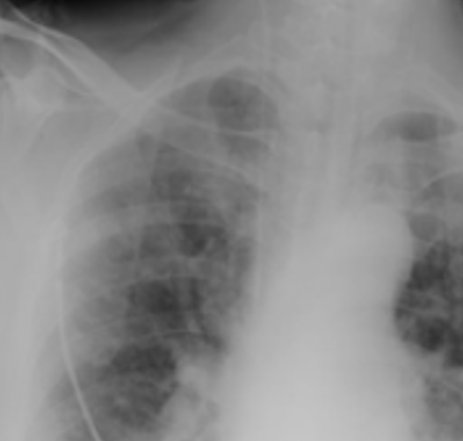
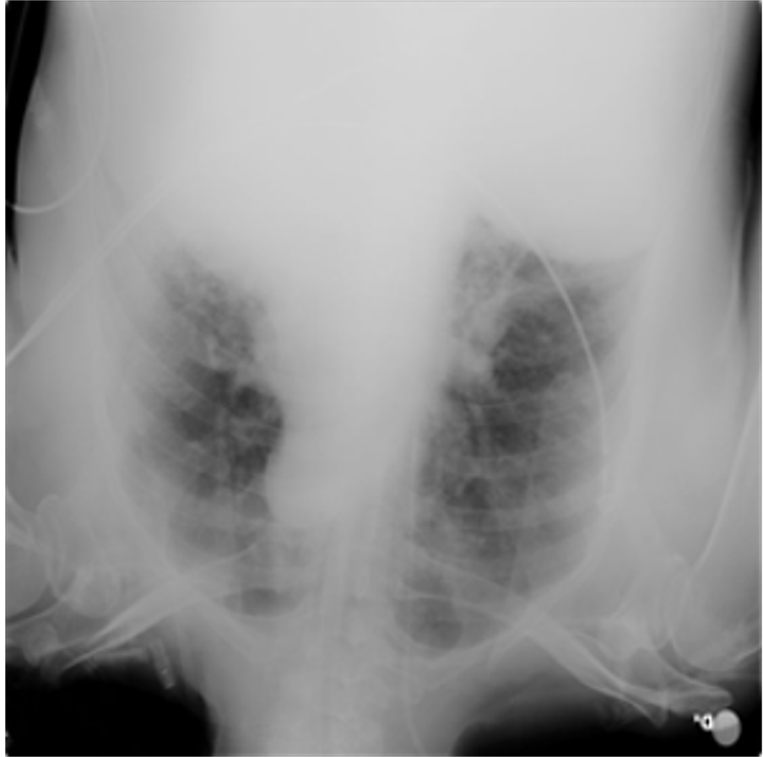
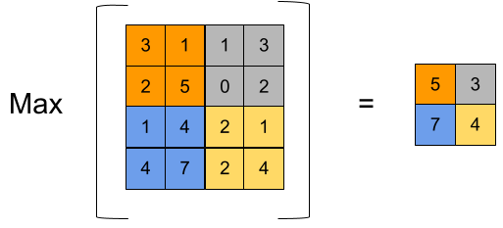
DATA PREPARATION
Image Resizing
Image Zooing
Image Flipping
Max-Pooling

Slide 6
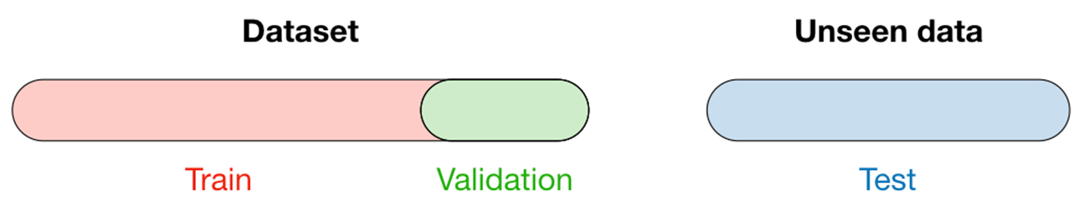
Splitting Images
Created 98 batches with 32 images in each batch.
Train Test Validation-> 79, 10, 9.

Slide 7
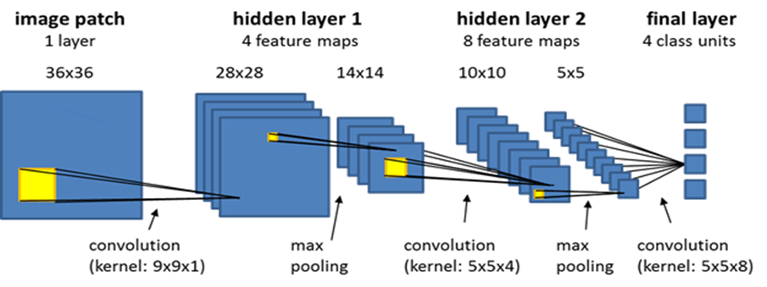
Model Building
Tools- Python, Keras, Tensorflow
Methodology- Convolutional Neural Networks

Slide 8
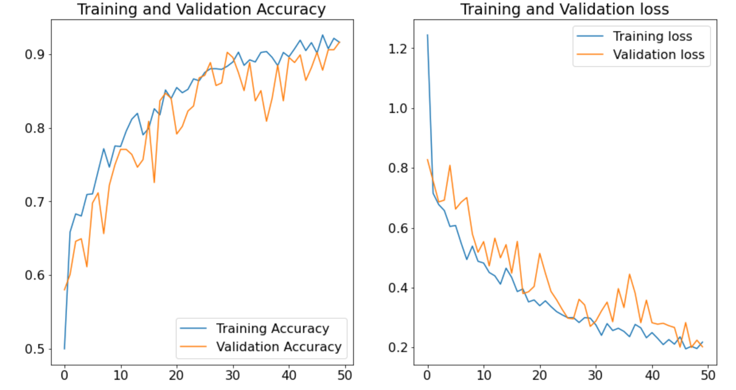
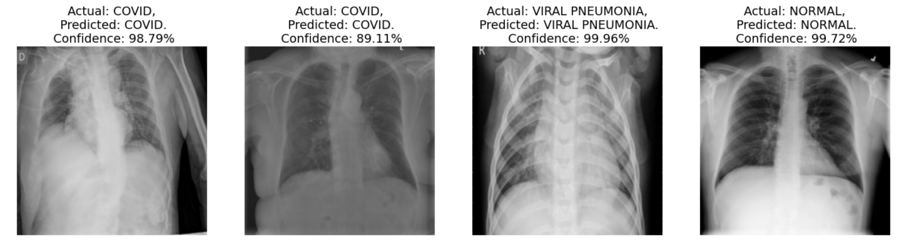
Model Evaluation
Accuracy- 92%
Loss Function (Categorical Cross Entropy)- 0.2
Confidence:

Slide 9
Thank You!

